Slide 1



Federated Learning-based Cross-Layer Security Design for Satellite Networks
Nan Cheng
Linlin Liang
3
Tom H. Luan
Zhisheng Yin
Yonghong Liu
1
2
Wenbin Sun
4
1
2
zsyin@xidian.edu.cn
liuyh_1@stu.xidian.edu.cn
dr.nan.cheng@ieee.org
llliang@xidian.edu.cn
sunwenbin@nwpu.edu.cn
tom.luan@xidian.edu.cn
23 August 2024
1
School of Telecommunications Engineering, Xidian University, Xi’an, China
2
School of Cyber Engineering, Xidian University, Xi’an, China
3
School of Electronics and Information, Northwestern Polytechnical University, Xi’an, China
4
School of Cyber Science and Engineering, Xi’an Jiaotong University, Xi’an, China

Slide 2
CONTENT
1
INTRODUCTION
2
SYSTEM MODEL
3
FL-based Cross-layer Security Design
4
SIMULATION RESULT
4
5
CONCLUSION

Slide 3
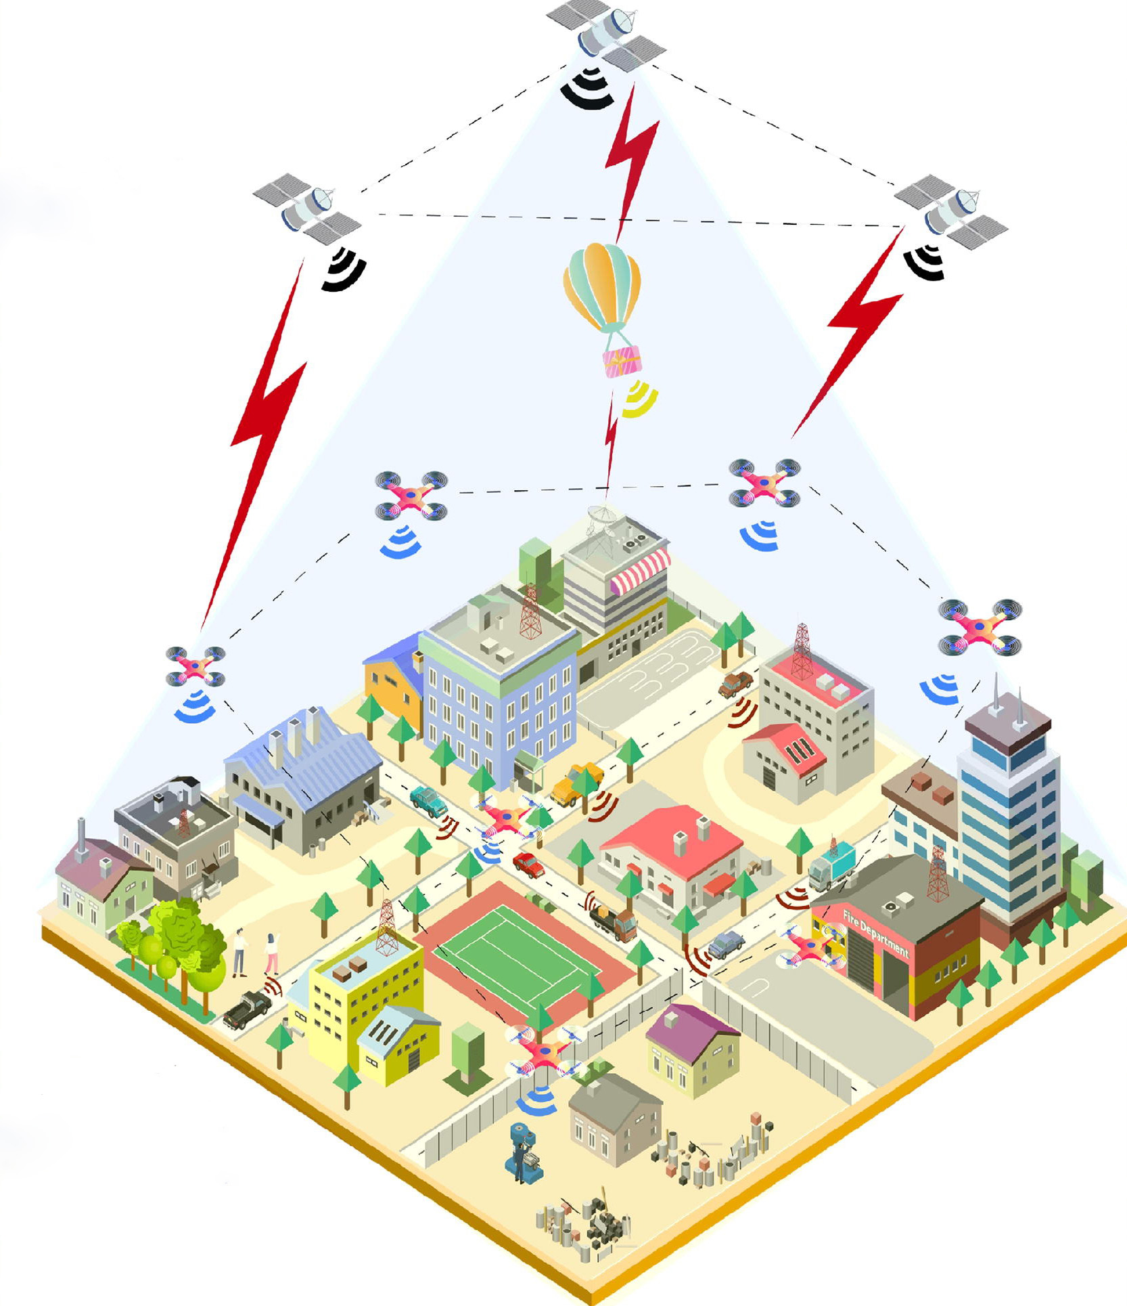
INTRODUCTION
Background
The proliferation of satellite networks has played a crucial role in achieving ubiquitous global connectivity.
The high coverage characteristics can provide adequate communication resources to underserved and remote areas.
The massive data transmission can burden communication links. Additionally, the openness and extensive coverage of wireless channels make communication susceptible to eavesdropping threats.
Satellite Air Ground Integrated Network

Slide 4



INTRODUCTION
Background
Federated learning has a distributed architecture, which offers advantages in achieving global connectivity.
Federated learning reduces data transmission volume and lowers communication bandwidth requirements by uploading model parameters.
The learning method of uploading and distributing model parameters greatly protects user data privacy and security.
Party C
Center
Party A
Party B
Federated Learning Architecture

Slide 5
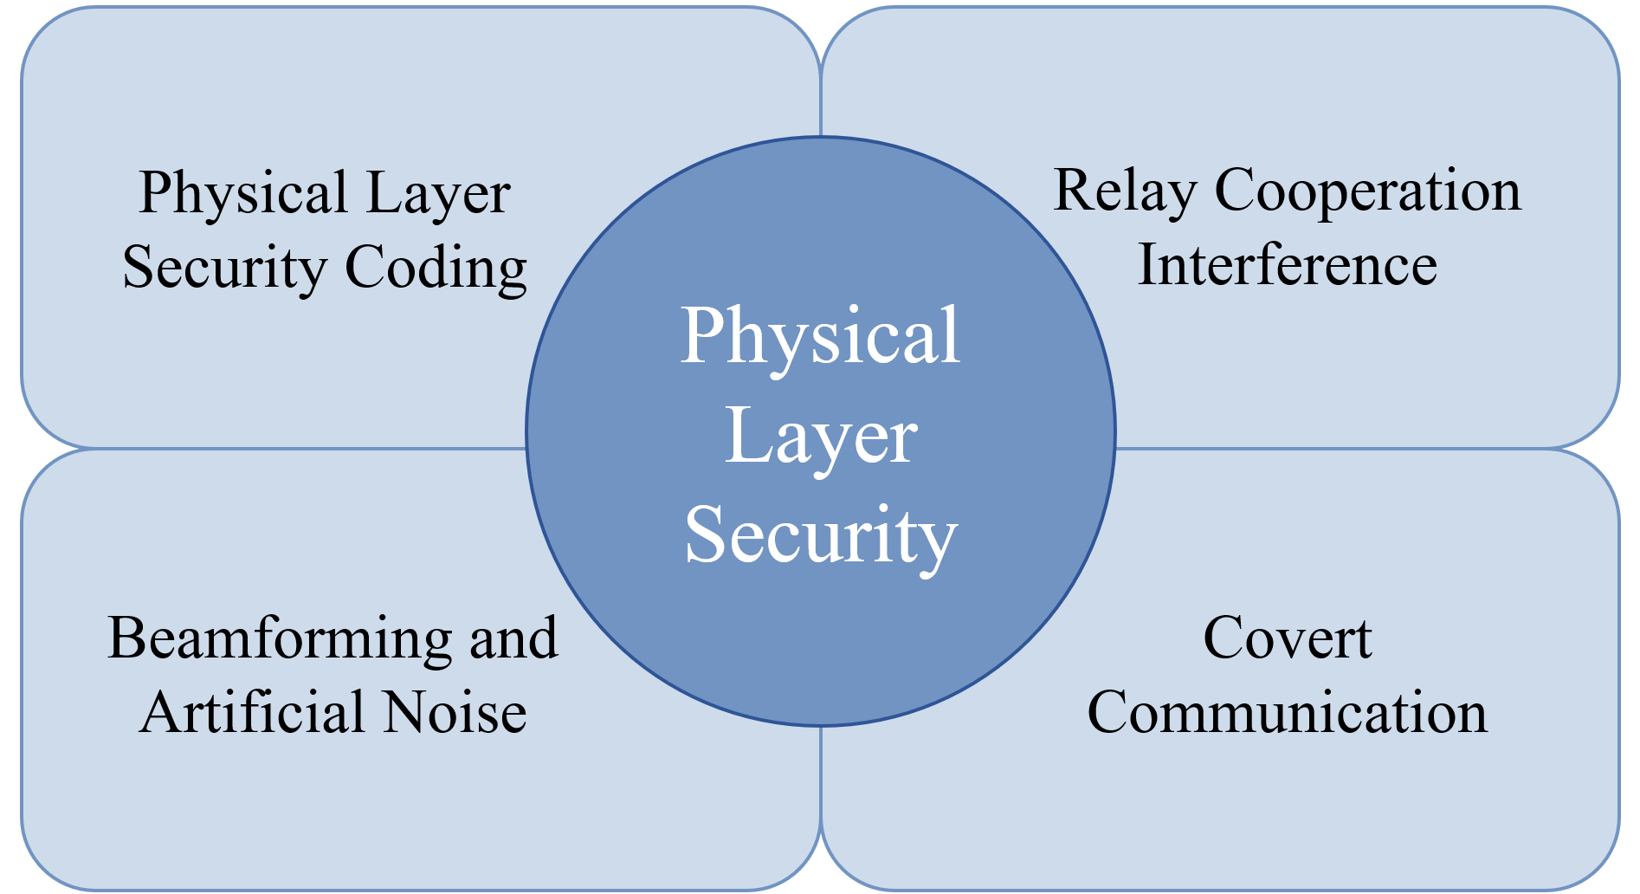
INTRODUCTION
Background
Security Risks in Federated Learning
FL faces various attacks and security risks.
Leakage of model parameters poses various security risks.
Physical Layer Security
Prevent the interception of useful information.
Adopt methods such as resource allocation and beamforming optimization.

Slide 6
INTRODUCTION
Problem and Approach
Problem
Distributed Network
FL Architecture
Physical layer security issues is too complex solve, and the model parameter update process in FL training is overly idealized.
Physical Layer Security Transmission in Federated Learning Architecture
Approach
An unsupervised learning method was proposed to solve the non-convex physical layer security problem. Cross-layer relationship formulation is introduced to concretely represent the impact of the transmission process on model parameters.
Impact of Transmission Process on Model Parameter Accuracy
Approach and Implementation Workflow

Slide 7
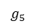
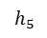
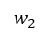
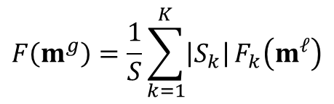
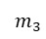
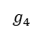
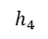
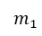
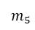
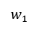
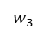
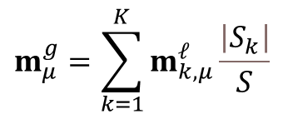
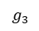
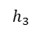
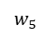
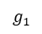
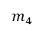
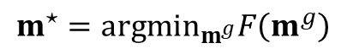
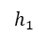
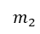
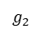
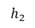
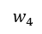
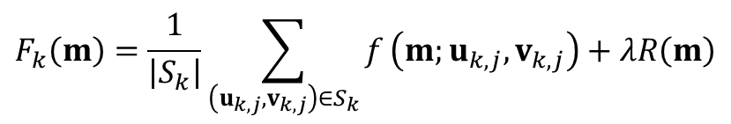
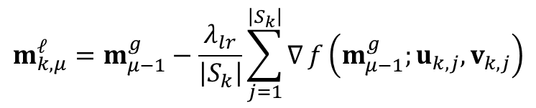
SYSTEM MODEL
Federated Learning Model
$$F\left(m^{g}\right)=\frac{1}{S}\sum_{k=1}^{K}{\left|S_{k}\right|}F_{k}\left(m^{𝓁}\right)$$
Global Loss
$$F_{k}\left(m\right)=\frac{1}{\left|S_{k}\right|}\sum_{\left(u_{k,j},v_{k,j}\right)∈S_{k}}{f}\left(m;u_{k,j},v_{k,j}\right)+λR\left(m\right)$$
Eve
Server
Local Loss
$$g_{1}$$
$$g_{2}$$
$$g_{3}$$
$$g_{4}$$
$$g_{5}$$
Local Model Loss
$$m^{⋆}=arg\min_{m^{g}}F\left(m^{g}\right)$$
$$h_{1}$$
$$h_{2}$$
$$h_{3}$$
$$h_{4}$$
$$h_{5}$$
$$w_{1}$$
$$w_{2}$$
$$w_{3}$$
$$w_{4}$$
$$w_{5}$$
$$m_{μ}^{g}=\sum_{k=1}^{K}{m_{k,μ}^{𝓁}}\frac{\left|S_{k}\right|}{S}$$
$$m_{1}$$
$$m_{2}$$
$$m_{3}$$
$$m_{4}$$
$$m_{5}$$
Model Aggregation
$$m_{k,μ}^{𝓁}=m_{μ−1}^{g}−\frac{λ_{lr}}{\left|S_{k}\right|}\sum_{j=1}^{\left|S_{k}\right|}{∇}f\left(m_{μ−1}^{g};u_{k,j},v_{k,j}\right)$$
Model Update
Local model upload process

Slide 8



SYSTEM MODEL
Communication Scenario
Eavesdropping channel:
Legitimate_channel:
Uplink transmission
Satellite acts as server to aggregate model parameters, clients serve as base stations to train local model
Communication is susceptible to satellite eavesdropping
Co-channel interference → green interference
Eve
Server
Upload local model
Client1
Client3
Client5
Client2
Client4
Satellite-Ground Integrated Network

Slide 9
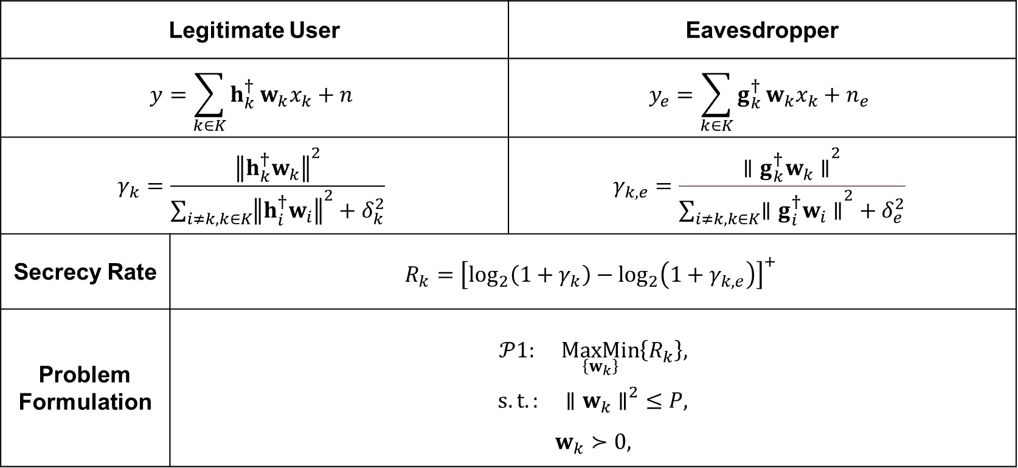
SYSTEM MODEL
Signal Model and Problem Formulation
Legitimate User |  | Eavesdropper
$$y=\sum_{k∈K}{h_{k}^{†}}w_{k}x_{k}+n$$ |  | $$y_{e}=\sum_{k∈K}{g_{k}^{†}}w_{k}x_{k}+n_{e}$$
$$γ_{k}=\frac{{∥h_{k}^{†}w_{k}∥}^{2}}{\sum_{i≠k,k∈K}^{​}{{∥h_{i}^{†}w_{i}∥}^{2}}+δ_{k}^{2}}$$ |  | $$γ_{k,e}=\frac{{\left.∥g_{k}^{†}w_{k}∥\right.}^{2}}{\sum_{i≠k,k∈K}{{\left.∥g_{i}^{†}w_{i}∥\right.}^{2}}+δ_{e}^{2}}$$
Secrecy Rate | $$R_{k}={\left[\log_{2}\left(1+γ_{k}\right)−\log_{2}\left(1+γ_{k,e}\right)\right]}^{+}$$
Problem Formulation | $$𝒫1: \underset{\left\{w_{k}\right\}}{MaxMin}\left\{R_{k}\right\},$$ $$s.t.: {\left.∥w_{k}∥\right.}^{2}≤P,$$ $$w_{k}≻0,$$

Slide 10


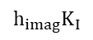


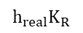


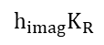


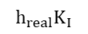
FL-based Cross-layer Security Design
Data Processing
Since the channel parameters are modeled as a 1*N-dimensional complex vector, directly inputting the complex numbers into the neural network is not feasible.
Imaginary Channel Vector
$$h_{imag}K_{I}$$
$$h_{real}K_{I}$$
$h_{imag}K_{R}$ + $h_{real}K_{I}$
$$∗$$
$$∗$$
Real Channel Vector
$$∗$$
$$h_{imag}K_{R}$$
$$h_{real}K_{R}$$
Imaginary Kernels
$$∗$$
$$∗$$
$h_{real}K_{R}$ - $h_{imag}K_{I}$
Real Kernels

Slide 11
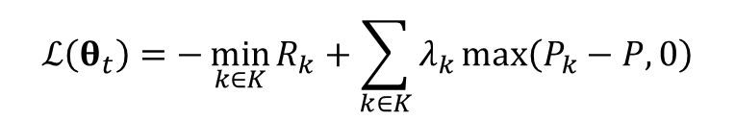
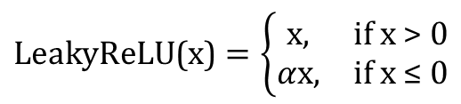
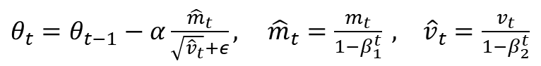
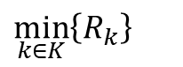
FL-based Cross-layer Security Design
Neural Network Architecture
Channel Matrix
Objective function
$$\min_{k∈K}\left\{R_{k}\right\}$$
$$\text{LeakyReLU}\text{(}\text{x}\text{)}=\left\{\begin{matrix}\text{x}, & \text{if} \text{x}\text{ > 0} \\ α\text{x}, & \text{if} \text{x}\text{ ≤ 0}\end{matrix}\right.$$
Activation function
Complex Convolution Layer
Gradient update rule: Adam algorithm
Complex Convolution Layer
$θ_{t}=θ_{t−1}−α\frac{{\hat{m}}_{t}}{\sqrt{{\hat{v}}_{t}}+ε},$ ${\hat{m}}_{t}=\frac{m_{t}}{1−β_{1}^{t}} , {\hat{v}}_{t}=\frac{v_{t}}{1−β_{2}^{t}}$
$$m_{t}=β_{1}m_{t−1}+\left(1−β_{1}\right)ℒ\left(θ_{t}\right), v_{t}=β_{2}v_{t−1}+\left(1−β_{2}\right)ℒ{\left(θ_{t}\right)}^{2}$$
Complex Convolution Layer
$$ℒ\left(θ_{t}\right)=−\min_{k∈K}{R_{k}}+\sum_{k∈K}{λ_{k}}max\left(P_{k}−P,0\right)$$
Loss function
Output

Slide 12
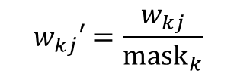
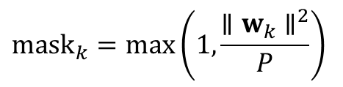
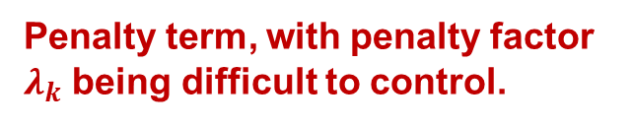
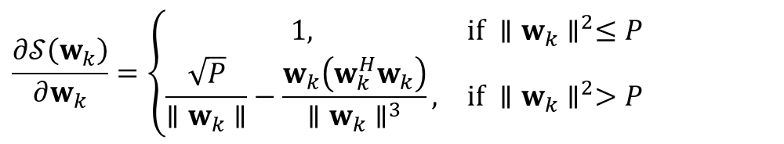
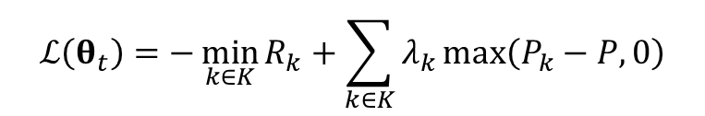
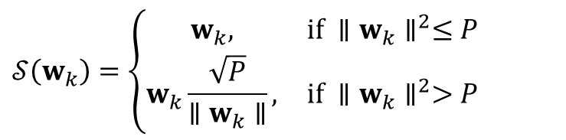
FL-based Cross-layer Security Design
Constraint Equivalence Replacement
$$ℒ\left(θ_{t}\right)=−\min_{k∈K}{R_{k}}+\sum_{k∈K}{λ_{k}}max\left(P_{k}−P,0\right)$$
Penalty term, with penalty factor $λ_{k}$ being difficult to control.
Loss function
$$𝒮\left(w_{k}\right)=\left\{\begin{matrix}w_{k}, & \text{if} ∥w_{k}∥^{2}≤P \\ w_{k}\frac{\sqrt{P}}{∥w_{k}∥}, & \text{if} ∥w_{k}∥^{2}>P\end{matrix}\right.$$
Activation Function
$$\frac{∂𝒮\left(w_{k}\right)}{∂w_{k}}=\left\{\begin{matrix}1, & \text{if} ∥w_{k}∥^{2}≤P \\ \frac{\sqrt{P}}{∥w_{k}∥}−\frac{w_{k}\left(w_{k}^{H}w_{k}\right)}{∥w_{k}∥^{3}}, & \text{if} ∥w_{k}∥^{2}>P\end{matrix}\right.$$
$${mask}_{k}=max\left(1,\frac{∥w_{k}∥^{2}}{P}\right)$$
$$w_{kj}′=\frac{w_{kj}}{{\text{mask}}_{k}}$$
Beamforming Mask

Slide 13
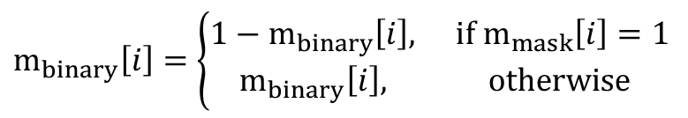
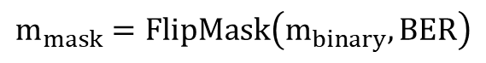
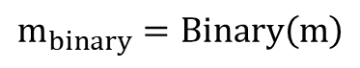
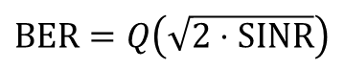
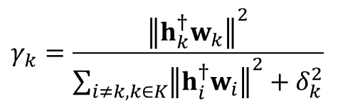
FL-based Cross-layer Security Design
Cross-Layer Relationship Formulation
The federated learning model parameter update process is not entirely ideal, so we aim to explore the impact of the physical layer transmission process on model parameters to reflect the influence between different layers.
$$γ_{k}=\frac{{∥h_{k}^{†}w_{k}∥}^{2}}{\sum_{i≠k,k∈K}^{​}{{∥h_{i}^{†}w_{i}∥}^{2}}+δ_{k}^{2}}$$
SINR Calculation
Bit Error Rate(BER)
$$BER=Q\left(\sqrt{2⋅SINR}\right)$$
Binary Model Vector
$$m_{binary}=Binary\left(m\right)$$
Flip Mask
$$m_{mask}=FlipMask\left(m_{binary},BER\right)$$
$$m_{binary}\left[i\right]=\left\{\begin{matrix}1−m_{binary}\left[i\right], & \text{if}{ m}_{mask}\left[i\right]=1 \\ m_{binary}\left[i\right], & \text{otherwise}\end{matrix}\right.$$

Slide 14
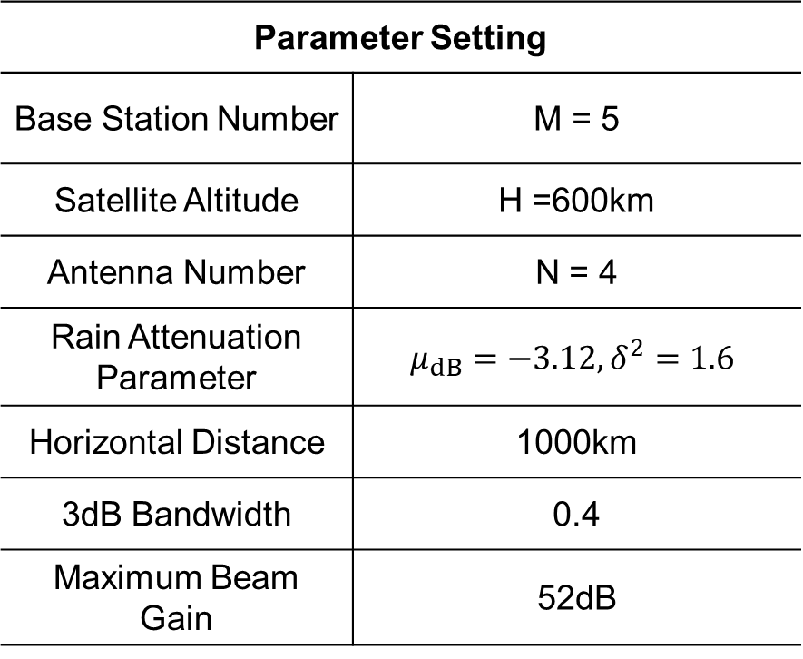
SIMULATION RESULT
Parameter Setting
Base Station Number | M = 5
Satellite Altitude | H =600km
Antenna Number | N = 4
Rain Attenuation Parameter | $$μ_{dB}=−3.12, δ^{2}=1.6$$
Horizontal Distance | 1000km
3dB Bandwidth | 0.4
Maximum Beam Gain | 52dB
The impact of power optimization on the minimum secrecy rate.
(H = 600km, M=5, N=4)
Parameter settings

Slide 15
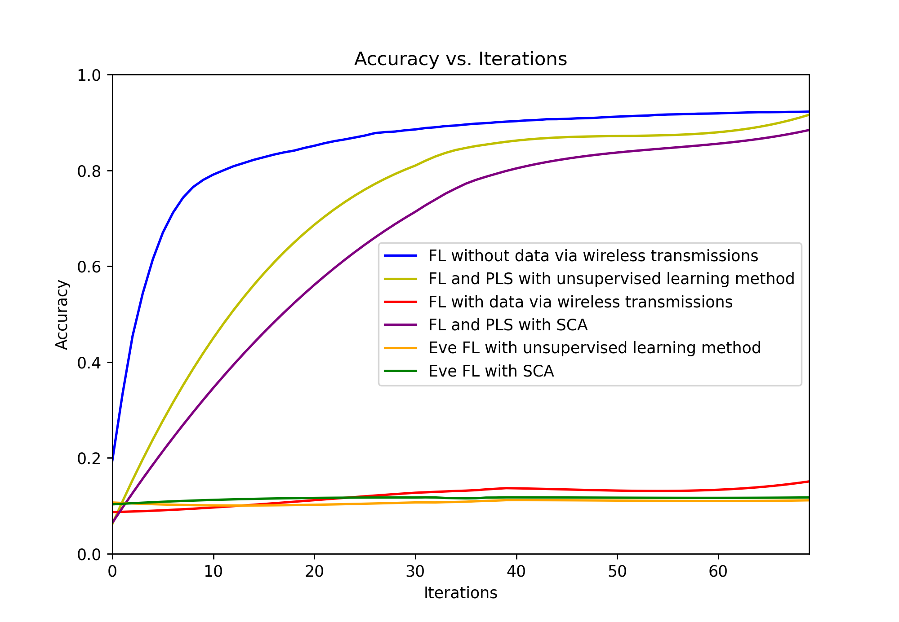
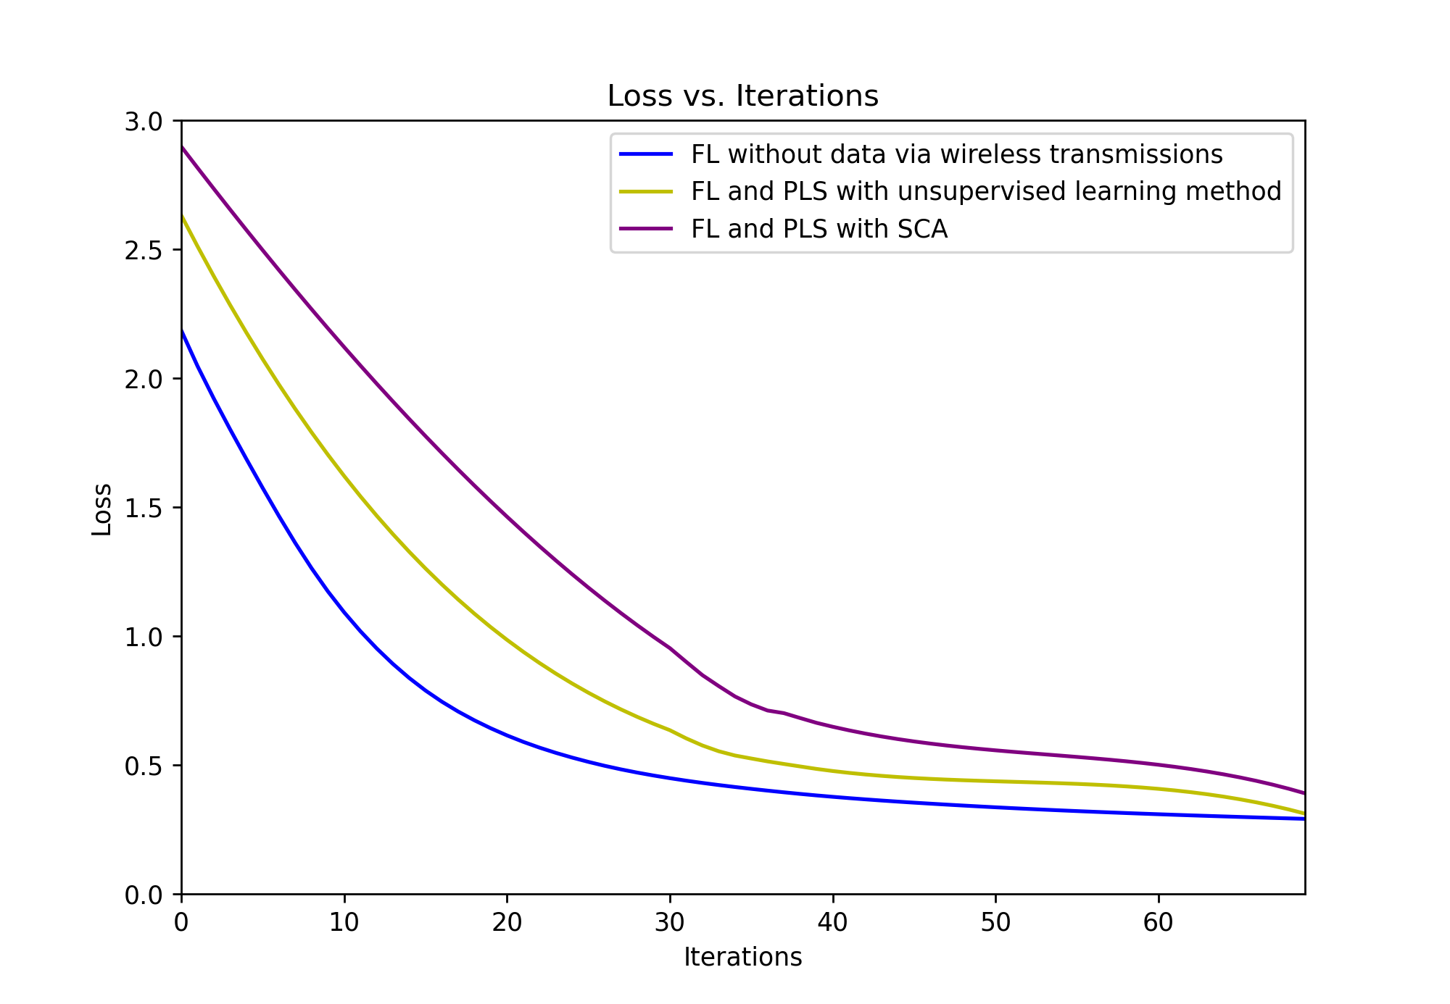
SIMULATION RESULT
Performance of Federated Learning Training Accuracy Under Different Physical Layer Security Transmission.
(P=10dB, M=5, N=4)
Performance of Federated Learning Training Loss Under Different Physical Layer Security Transmission.
(P=10dB, M=5, N=4)

Slide 16
CONCLUSION
Contributions
An unsupervised learning method is proposed to solve physical layer security issues, offering better physical layer security transmission performance compared to traditional solutions.
We explored the relationship between physical layer security transmission and federated learning performance. While the training performance considering the actual transmission process is somewhat lower than in ideal conditions, it holds greater practical significance.
Reflections
In the future, further refining the modulation and demodulation process at the transmission and reception ends will add more practical significance to the research. Additionally, the security of the downlink transmission in federated learning also requires further consideration.

Slide 17
THANKS

